Slide 1

Cybersecurity in Healthcare
Allen Zhu
Notes:
Hello, my name is Allen Zhu and today I will be going over a quick powerpoint on Cybersecurity in Healthcare. Cybersecurity is an increasingly important as we use more electronic records in healthcare. In this presentation, I will go over what is cybersecurity, the safeguards and threats involved, and the importance of it now and for the future.

Slide 2
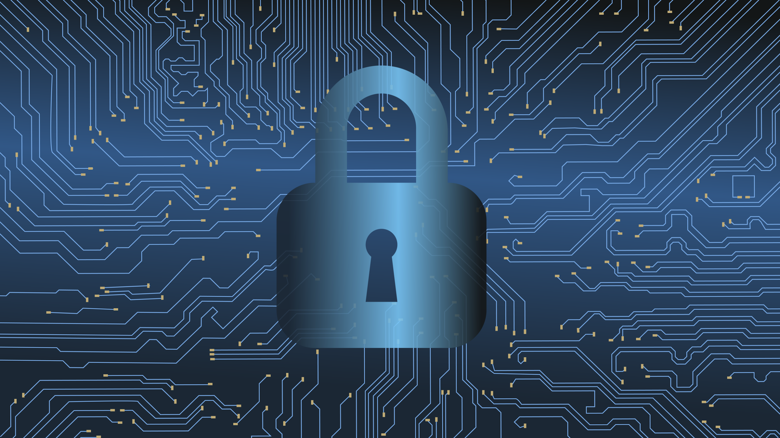
What is Cybersecurity in Healthcare?
Safeguard Health Technology
Secure Confidential Health Data
Protect Patients and Care Outcomes
Notes:
Cybersecurity includes the electronic, training, and physical security measures hospitals and healthcare facilities take to protect patient healthcare information. They safeguard valuable health technology from outside influence, thereby securing confidential health data, and protecting patients and care outcomes. Patients are cared for knowing their information is safe and services are optimal.

Slide 3

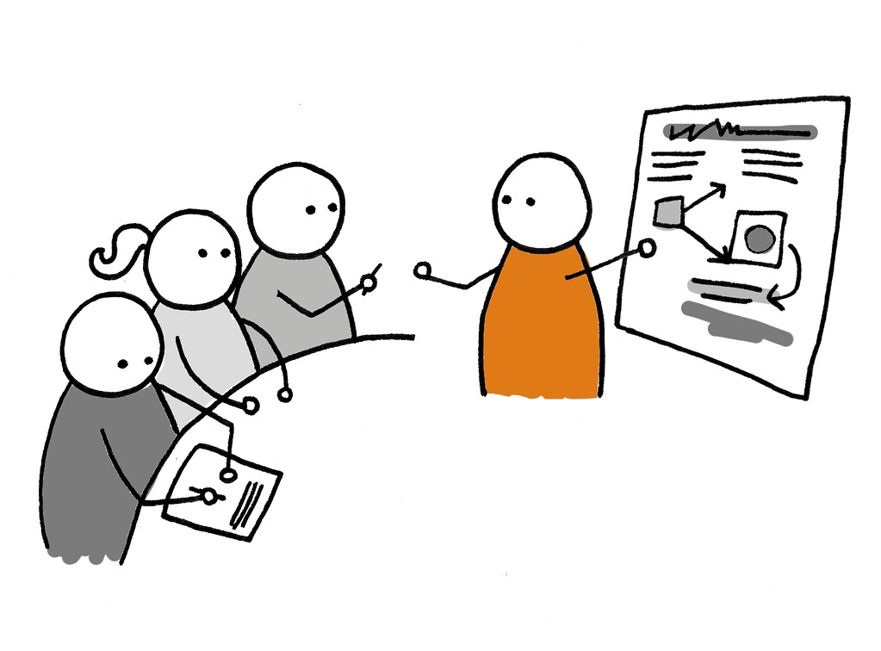

Examples of Cybersecurity
Firewalls
Employee Training
Security Advisories
Notes:
Some examples of cybersecurity include the use of Internet/Network firewalls, employee training to avoid/prevent security breaches, and security advisories to warn organizations of emerging cyber threats.

Slide 4

Cybersecurity Attacks
Phishing: Stealing Identifying Info
Denial of Service (DDOS): Denying Network Availability
Ransomware: Blocking Data Access
Notes:
Cybersecurity attacks include phishing, DDOS (Denial-of-service), and Ransomware attacks. Phishing includes steals employee ID info, threatening a health systems security. DDOS can shut down servers or networks, preventing access to healthcare websites. Ransomware prevents healthcare workers from accessing patient data unless a ransom is paid.

Slide 5
Whitehat Hacking
3. Fix Security Issues
1. Design an Information System
Ethical Hacking
Realistic Approach
System Security Cycle
2. ‘Hack’ the System
Notes:
Whitehat Hacking is an ethical way to hack a health system. A whitehat hacking group hacks a health information system, identfies weaknesses, and passes on information to the system designers to fix.

Slide 6
42%
HealthIT Security (2021) notes a...
increase in Cyber Attacks in 2020,
affecting 31 million patients.
Notes:
Since 2019, cyberattacks against health systems have increased by 42%, affecting 31 million patients.

Slide 7
31 Million Patients
Notes:
31 million patient have been affected by cybersecurity breaches, almost the population of Canada. I think this emphasizes the importance of cybersecurity.

Slide 8
Thank You!
The End

Slide 9
References
Davis, J. (2021, March 16). Healthcare Hacking Incidents Rose 42% in 2020, 31M Patients Impacted. HealthITSecurity. https://healthitsecurity.com/news/healthcare-hacking-incidents-rose-42-in-2020-31m-patients-impacted.
Sobers, R. (2020). What Does It Take To Be An Ethical Hacker? Varonis. https://www.varonis.com/blog/white-hat-hacker/
Enterprise Security Magazine. (2019). Why Cybersecurity is Important in the Healthcare Sector. Enterprise Security https://www.enterprisesecuritymag.com/news/why-cybersecurity-is-important-in-the-healthcare-sector-nid-1420-cid-62.html

