Slide 1
Cybersecurity in Healthcare
Allen Zhu

Slide 2
What is Cybersecurity in Healthcare?
Safeguard Health Technology
Protect Confidential Health Data
Protect Patients and Care Outcomes
Notes:
Cybersecurity are the electronic, training, and physical security measures hospitals and healthcare facilities take to protect patient healthcare information. They protect confidential health data and ensure patient outcomes and info are optimal.

Slide 3
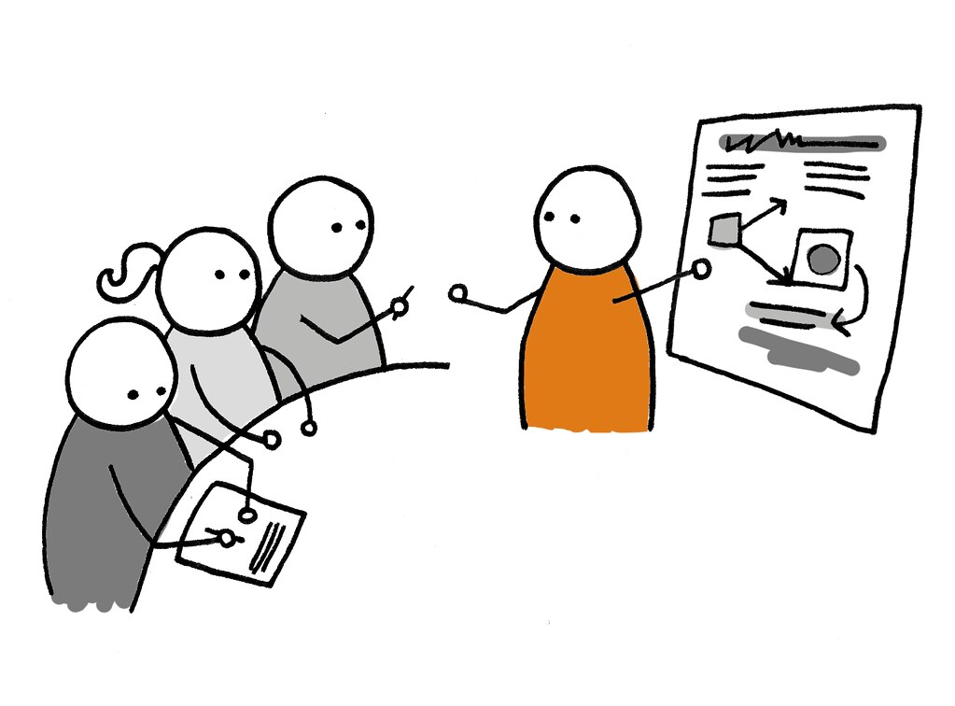
Examples of Cybersecurity
Firewalls
Employee Training
Security Advisories
Notes:
Some examples of cybersecurity include the use of Internet/Network firewalls, employee training to avoid/prevent security breaches, and security advisories to warn organizations of emerging cyber threats.

Slide 4
Cybersecurity Attacks
01
Phishing
Stealing Identifying Info
02
Denial of Service (DDOS)
Denying Network Availability
03
Ransomware
Blocking Data Access
Notes:
Cybersecurity attacks include phishing, DDOS (Denial-of-service), and Ransomware attacks. Phishing includes steals employee ID info, threatening a health systems security. DDOS can shut down servers or networks, preventing access to healthcare websites. Ransomware prevents healthcare workers from accessing patient data unless a ransom is paid.

Slide 5
Whitehat Hacking
3. Fix Security Issues
1. Design an Information System
Ethical Hacking
Realistic Approach
System Security Cycle
2. ‘Hack’ the System
Notes:
Whitehat Hacking is an ethical way to hack a health system. A whitehat hacking group hacks a health information system, identfies weaknesses, and passes on information to the system designers to fix.

Slide 6
42%
HealthIT Security (2021) notes a...
increase in Cyber Attacks in 2020,
affecting 31 million patients.
Notes:
Since 2019, cyberattacks against health systems have increased by 21%, affecting 31 million patients. The consequences of poor cybersecurity can have major consequences, and its important to for healthcare organizations do stay vigilant.

Slide 7
Thank You!
The End

Slide 8
References
Davis, J. (2021, March 16). Healthcare Hacking Incidents Rose 42% in 2020, 31M Patients Impacted. HealthITSecurity. https://healthitsecurity.com/news/healthcare-hacking-incidents-rose-42-in-2020-31m-patients-impacted.
Sobers, R. (2020). What Does It Take To Be An Ethical Hacker? Varonis. https://www.varonis.com/blog/white-hat-hacker/
Enterprise Security Magazine. (2019). Why Cybersecurity is Important in the Healthcare Sector. Enterprise Security https://www.enterprisesecuritymag.com/news/why-cybersecurity-is-important-in-the-healthcare-sector-nid-1420-cid-62.html

